Slide 1
Cloud Services
Group O - Eric Prytulla, Mintaha Tekdemir

Slide 2
Breakdown
Implementation
Scan
Lesson learnt
Live Demo

Slide 5
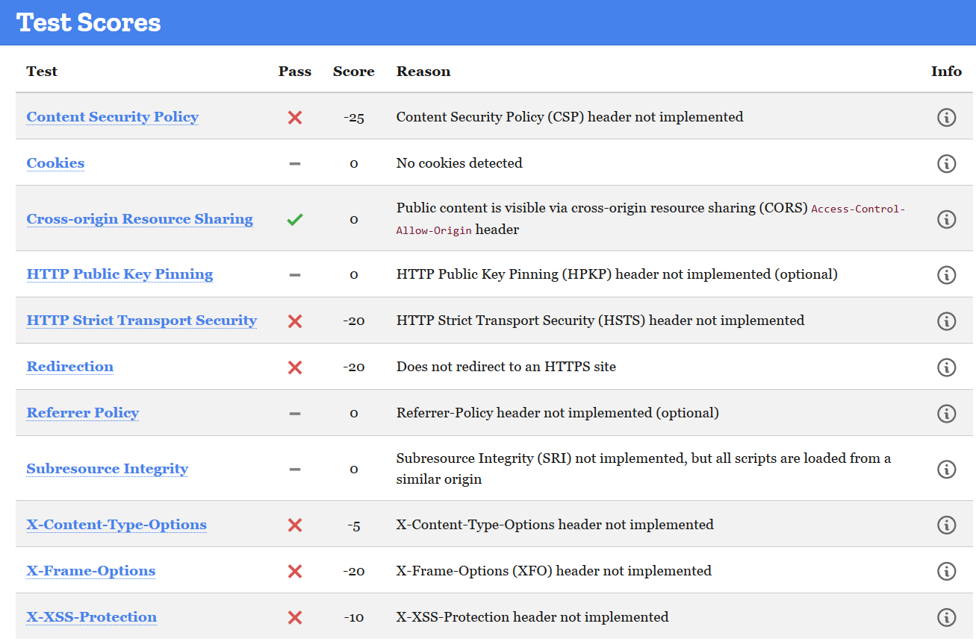
Scan

Slide 6
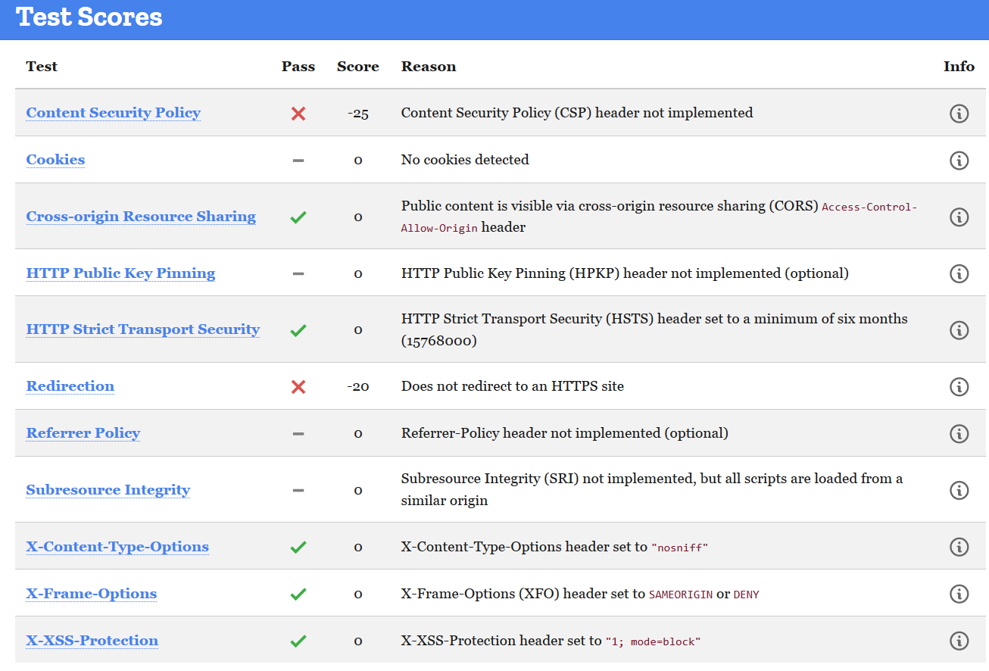
Scan

Slide 7
Lesson learnt

Slide 8
Live Demo

